Slide 1
Research Update
Frank
12/11/13

Slide 2
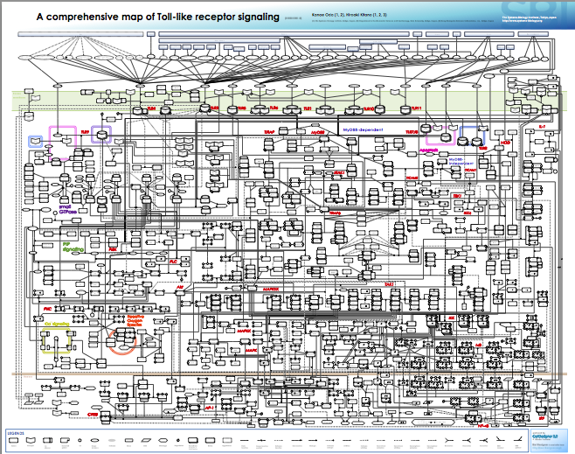
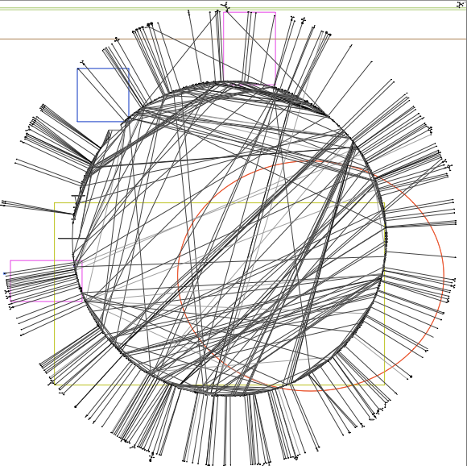
Innate immune signaling network are complex
TLRs: 11
No of species: 652
No of edges: 444

Slide 3

But we can find features from these complex network
-- double bow-tie
Notes:
http://www.nature.com/ni/journal/v4/n12/fig_tab/ni1203-1162_F1.html
Key node.

Slide 4
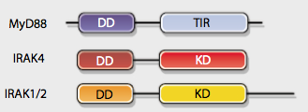
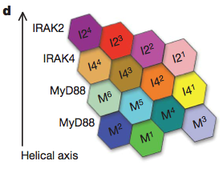
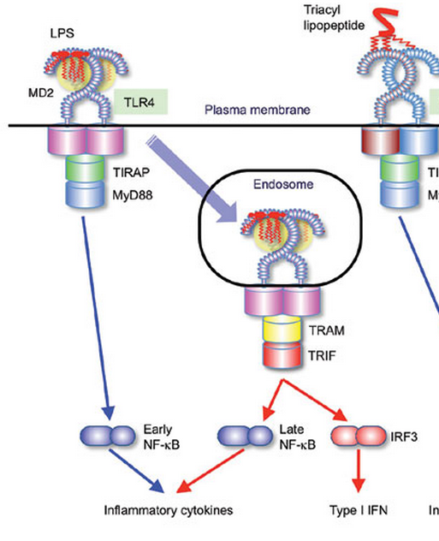
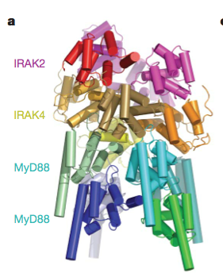
TLR4 is special
Dynamical features in the sub-pathways (quantitatively)
Molecular details in shaping the dynamics
Notes:
Single cells and population: Gave more fundamental molecular mechanism.
Auto/para-crine feedback via TNF (limited to MEFs).
First 4 hours at most.

Slide 5
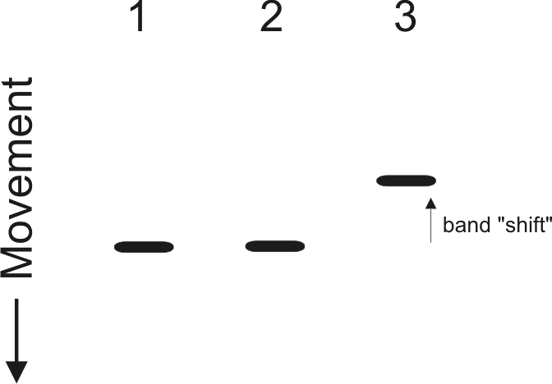
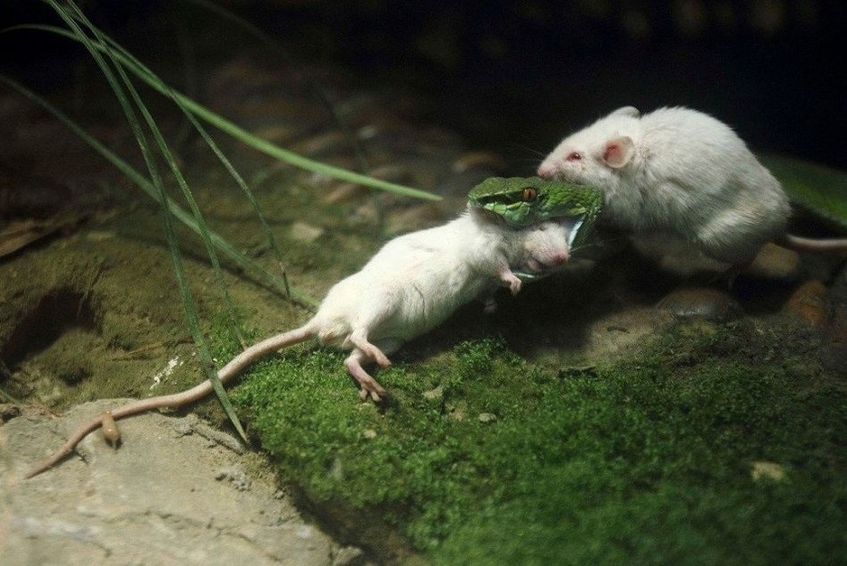

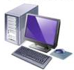

Method
Electrophoretic mobility shift assay
Kinase assay
Gene knockout mouse
Computational modeling

Slide 6
The TLR4 model diagram
3 compartments
41 species
100 Reactions
Notes:
Need reaction maps.

Slide 7
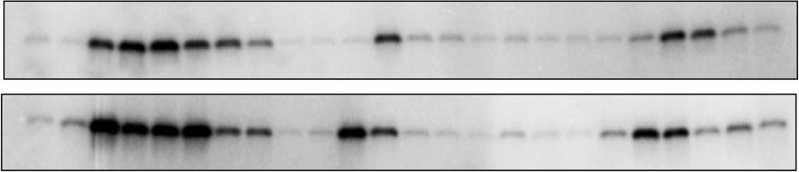
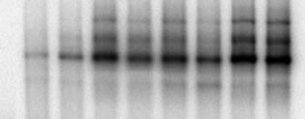
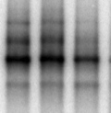
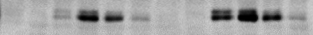
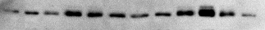
Model validation and experimental data
B
WT
trif ^{- /-}
myd88^{- / -}
LPS
15
120
120
120
min
30
45
60
90
15
30
45
60
90
15
30
45
60
0
90
5
0
5
0
5
1 ng/ml
IKK
100ng/ml
1 ng/ml LPS
100 ng/ml LPS
120
min
240
120
10
30
60
10
240
0
30
60
NF-κB_{n}
1 ng/ml LPS
100 ng/ml LPS
0
10
30
60
120
240
0
10
30
60
120
240
min
IRF3_{np}
IRF3_{n}
C
D
IKK
NFκBn
0.8
wt exp.
0.8
wt sim.
0.4
0.4
0
0
20
40
60
80
100
120
0
Level (Normalized to maximum)
Level (Normalized to maximum)
Time (min)
0
30
60
90
120
150
180
210
240
0.6
IRF3_{np}
0.8
wt exp.
0.4
wt sim.
0.2
0.4
0
0
20
40
60
80
100
120
0
0
30
60
90
120
150
180
210
240
Time (min)
Time (min)
Red: 100 ng/ml LPS; Blue: 1 ng/ml LPS
Red: 100 ng/ml LPS; Blue: 1 ng/ml LPS
wt exp.
wt sim.
mko exp.
mko sim.
tko exp.
tko sim.
Diana
Notes:
Always to question about how big your parameter space is. And how robustness about the parameter set.

Slide 8
Dynamics features in sub-pathways: duration, responsive speed
A
B
0.12
NFκBn
240
Response duration
Both
0.1
TRIF pathway
MyD88 pathway
180
0.08
Similar response slope
NFκBn (μM)
Response duration (min)
0.06
120
0.04
60
0.02
0
0
0
60
120
180
240
10⁻¹
10⁰
10¹
10²
C
Time (min)
D
LPS dose (ng/ml)
Response speed
Time of the maximum response
60
60
50
50
40
40
Half peak time (min)
Peak time (min)
30
30
20
20
10
10
Overlap response speed
0
0
10⁻¹
10⁰
10¹
10²
10⁻¹
10⁰
10¹
10²
LPS dose (ng/ml)
LPS dose (ng/ml)
Notes:
Similar response slop

Slide 9
Myddosome formation produce threshold in signaling activation
Input
Output
A
0.8
0.6
M^{ss}₆/M₀
0.4
0.2
Threshold
0
M^{ss}₆/M₀
C
B
1
0.8
0.8
3.2
0.6
3
0.6
2.8
k_{f}/k_{b}
0.4
Hill coefficient (n)
2.6
0.4
2.4
0.2
0.2
2.2
2
1
0
0.2
0.4
0.6
0.8
0
0
k_{f} /k_{b}
0
0.2
0.4
0.6
0.8
1
C₀/M₀
Notes:
Input

Slide 10
Response speed is most sensitive to the threshold.

Slide 11
The ligand induced-shuttling is responsible for the duration specificity
A
Notes:
Constitutively shuttling vs. ligand-induced shuttling

Slide 12

From cell population to single cell.
Before clustering
After clustering
B
NFκBn
C
NFκBn
1
1
1
1
50
0.8
50
LPS 1
0.8
A
0.6
0.6
100
100
f_{m}
0.4
0.4
150
150
LPS 2
MyD88
MyD88*
0.2
0.2
200
0
200
0
0
60
120
180
240
0
60
120
180
240
D
Time (min)
E
Time (min)
f_{t}
1
LPS 1
1
LPS 2
TRIF
TRIF*
Activation efficiency
Activation efficiency
0.5
0.5
0
0
MyD88 pathway
(f_{m})
TRIF pathway
(f_{t})
MyD88 pathway
(f_{m})
TRIF pathway
(f_{t})
LPS 1 need little Trif activation
Notes:
Randomize this figure.

Slide 13
Stochastic activation in Trif alone can generate two clusters
But but the stochasticity in MyD88 will bring in viability in response speed.

Slide 14
Conclusions:
Dynamical features in the sub-pathways (quantitatively):
MyD88 sub-pathway determine the response speed (linearly to log dose).
TRIF sub-pathway determine the response duration(linearly to log dose).
Molecular details in shaping the dynamics:
Myddosome formation produce threshold in signaling activation
The ligand induced-shuttling is responsible for the duration specificity
Stochasticity happens at the level of sub-pathway activation can explain single cell data
Stochastic activation in Trif alone can generate two clusters
But but the stochasticity in MyD88 will bring in viability in response speed.
Notes:
Conclusions:

Slide 15
What’s next?
TNF
CpG
LPS
dsRNA
TNFR
TLR9
TLR4
TLR3
Werner et al
G&D 2008
MyD88
TRIF
IKK
TBK
TNF
Production
Werner et al
Science 2005
NF-κB
IRF3
TNF
With Andrew
κB
Notes:
Why TNF? Ask Andrew. – Tumor necrosis factor

Slide 16
Step1: Transcription + RNA processing
LPS
RNA processing
TRIF*
MyD88*
NFκB
Transcription, f(NFkB)
TNF
κB
Notes:
f(NFkB)

Slide 17
Step2: RNA processing + stabilization
LPS
RNA processing
TRIF*
MyD88*
Notes:
6 fold less in MyD88 ko

Slide 18
Step3: Translation + Secretion
Secretion
Translation
LPS
TRIF*
MyD88*
Notes:
f(NFkB)

Slide 19
Step4: Linking with TLR4 model
Secretion
LPS
TLR4 module
Translation
TRIF*
MyD88*
IKK module
RNA processing
IKK
NFκB module
NFκB
Transcription, f(NFkB)
TNF
κB
Notes:
f(NFkB)

Slide 20
Step5: Place p38 and pERK
Secretion
LPS
p
ERK
TLR4 module
Translation
p
ERK
TRIF*
MyD88*
p
P38
Secretion
RNA processing
?
IKK module
IKK
?
NFκB module
p
P38
Translation
NFκB
?
Transcription, f(NFkB)
TNF
Stabilization
κB
Notes:
?

Slide 21
Step6: CpG and PIC
Secretion
CpG
dsRNA
LPS
p
ERK
TLR module
Translation
TRIF*
MyD88*
p
P38
IKK module
RNA processing
IKK
NFκB module
NFκB
Transcription, f(NFkB)
TNF
κB
Notes:
?

Slide 22
Step7 : CpG and LPS TNF feedback
Secretion
CpG
dsRNA
LPS
p
ERK
TT
TLR module
Translation
TNFR module
TRIF*
MyD88*
p
P38
IKK module
RNA processing
IKK
NFκB module
NFκB
Transcription, f(NFkB)
TNF
κB

Slide 23
Thank you !

